Slide 1

Final Project for QA Path
Presented by: Motasem Douli

Slide 2

Software Quality Assurance in Modern Web Applications
Software Quality Assurance plays a critical role in ensuring reliable and secure web applications. Modern web systems require comprehensive testing at multiple levels: user interface, API endpoints, and performance metrics.
This project represents a practical QA case study for a web-based e-commerce system, focusing on validating functionality, reliability, and performance using industry-standard tools. It demonstrates end-to-end website testing aligned with professional QA methodologies.

Slide 3
PROJECT OVERVIEW
Scope, Objectives, and System Under Test
Testing Scope
Key Objectives
The project focuses on quality assurance for a web-based e-commerce application, encompassing both frontend web UI and backend RESTful APIs. Testing was performed on a simulated production-like environment using public test platforms.
Verify core user workflows including authentication, product browsing, and checkout processes
Ensure backend APIs return correct, consistent, and reliable responses
Evaluate system performance under normal and concurrent user load conditions

Slide 4
TESTING STRATEGY
QA Concepts and Testing Approach
Multi-Level Testing
QA Principles
Risk-Based Approach
UI testing validates user-facing functionality, API testing verifies backend logic and data integrity, and performance testing measures responsiveness and stability.
Applied core Quality Assurance principles to ensure systematic and repeatable testing, combining functional and non-functional testing approaches.
Used prioritisation of critical user flows and structured testing activities according to the Software Testing Life Cycle (STLC).

Slide 5
Testing Implementation and Tools
Testing Activities
Postman & Newman
k6
Manual testing was performed on the web UI to validate core user journeys. Automated API testing was implemented to verify backend functionality and data accuracy. Performance testing was conducted to evaluate system behaviour under load and baseline conditions.
Smoke and load performance testing
Automated API testing and reporting
Test execution focused on repeatability, reliability, and measurable outcomes across all testing phases.
Selenium WebDriver
UI automation for critical flows

Slide 6
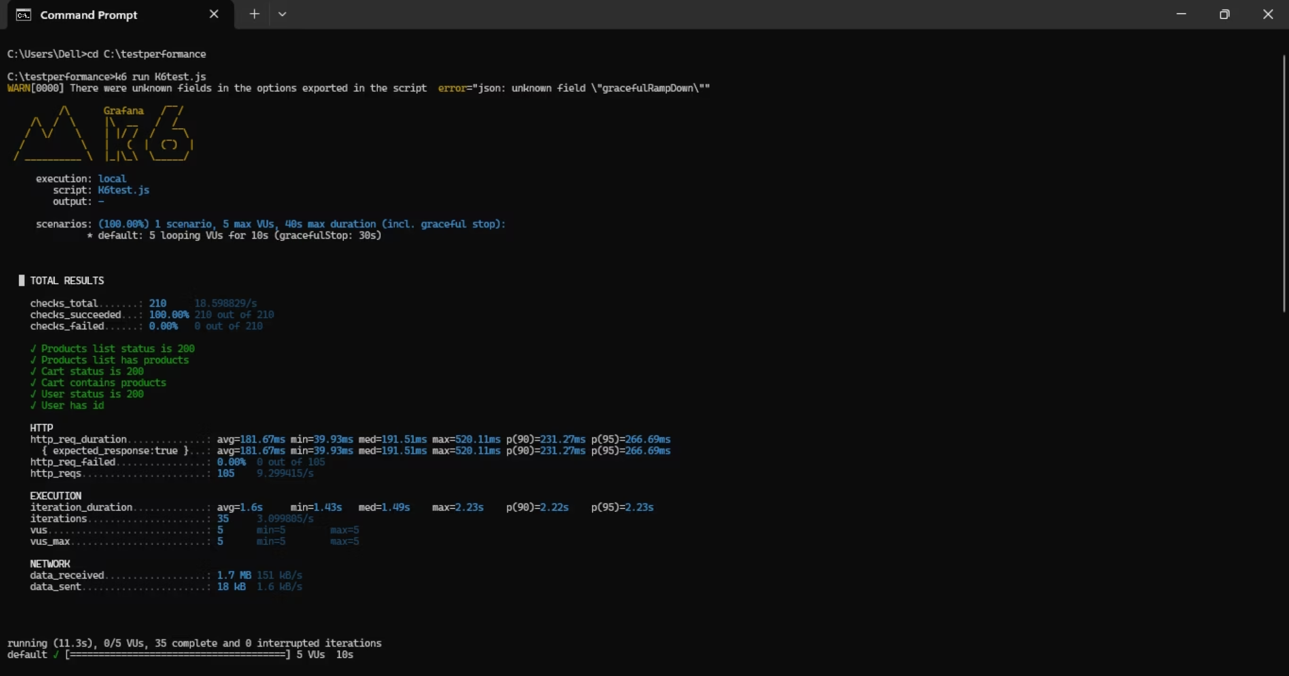

Slide 7
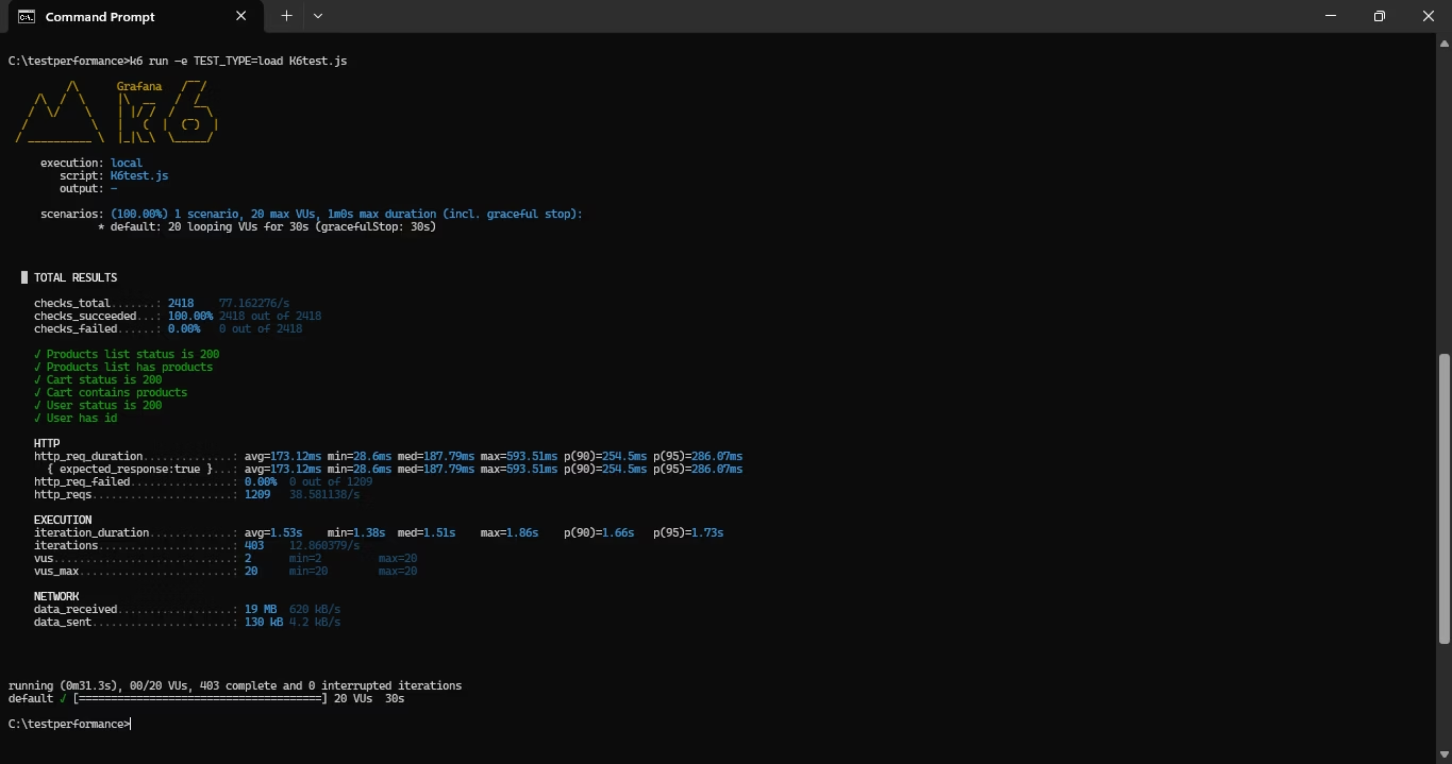

Slide 8


Test Results and Quality Analysis
100%
Testing Success Rate
All automated API and performance tests executed successfully
Key Findings
Manual UI testing identified functional defects related to user flows and UI behaviour, documented with severity levels for prioritisation
API testing: All automated tests passed with correct, consistent, and reliable responses
Performance testing: Stable response times under smoke and load conditions with no failed requests during concurrent user execution

Slide 9
Challenges, Limitations, and Lessons Learnt
Project Limitations
Key Lessons Learnt
Testing conducted on public demo platforms, limiting environment configuration and data control
Predefined static test data reduced coverage of edge cases
Performance testing used simulated load profiles rather than real production traffic
Security, accessibility, and cross-browser testing were outside scope
Importance of structured test planning and prioritization in resource-constrained environments
Value of combining manual, automated, and performance testing for comprehensive coverage
Using measurable metrics to support quality decisions and stakeholder communication

Slide 10



Conclusion and Future Improvements
The project successfully demonstrated a structured Quality Assurance approach for website testing. By combining manual, automated, and performance testing, comprehensive coverage was achieved within the defined scope. Results indicated a stable and reliable web application meeting functional and performance requirements.
Expand Test Coverage
Develop full regression suites for automated testing across all application modules
Enhanced Performance Testing
Execute performance tests with higher and variable loads to simulate real-world traffic patterns
Broaden Testing Scope
Include security, accessibility, and cross-browser testing for comprehensive quality assurance
Overall, this project reflects practical application of industry-aligned QA methodologies and tools, providing valuable insights for academic and professional contexts.

Slide 11

Thank you for your attention

